Slide 1



OCIALIZO
CONNECTING ALL OF US WITH THE WORLD..

Slide 2
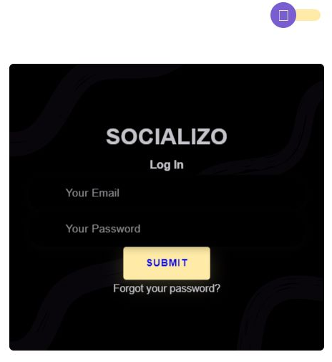

LOGIN

Slide 3
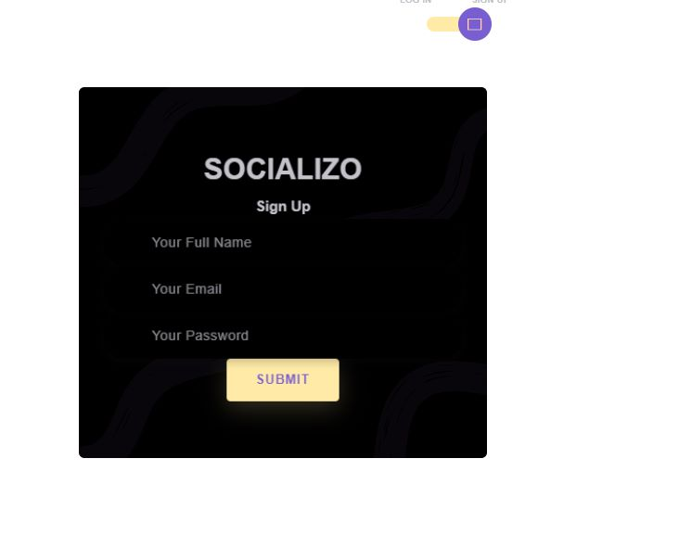


IGN UP
CREATE NEW ACCOUNT
ENJOY YOUR SHOWS

Slide 4
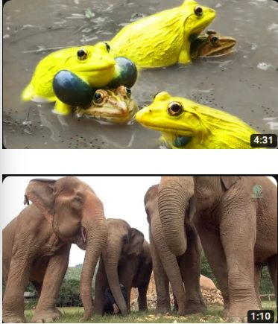

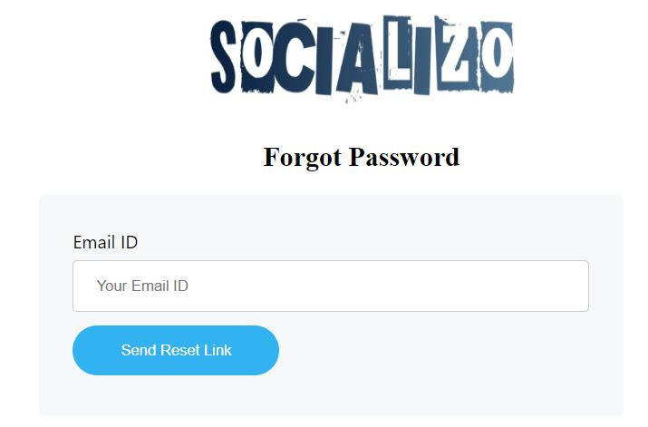
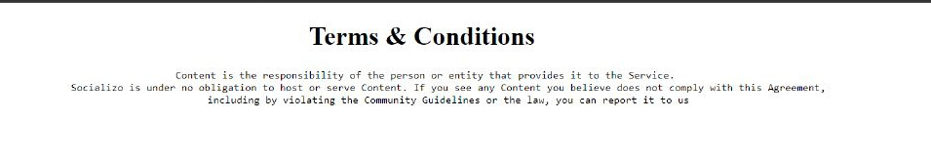
RESET PASSWORD

Slide 5
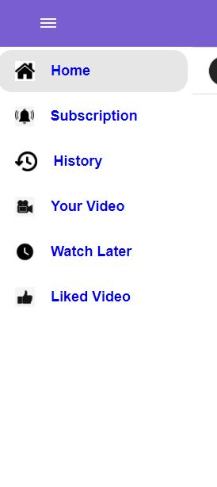
WEB INTERFACE
ENJOY ALL THE CONENTS YOU NEED
AT ANYWHERE AND ANYTIME ..
YOUR DAILY DOSE OF GOOD VIBES
Laugh Harder
Think Different
Enjoy Sports,Movies etc..
Travel when you watch
We entertain until we drop

Slide 6
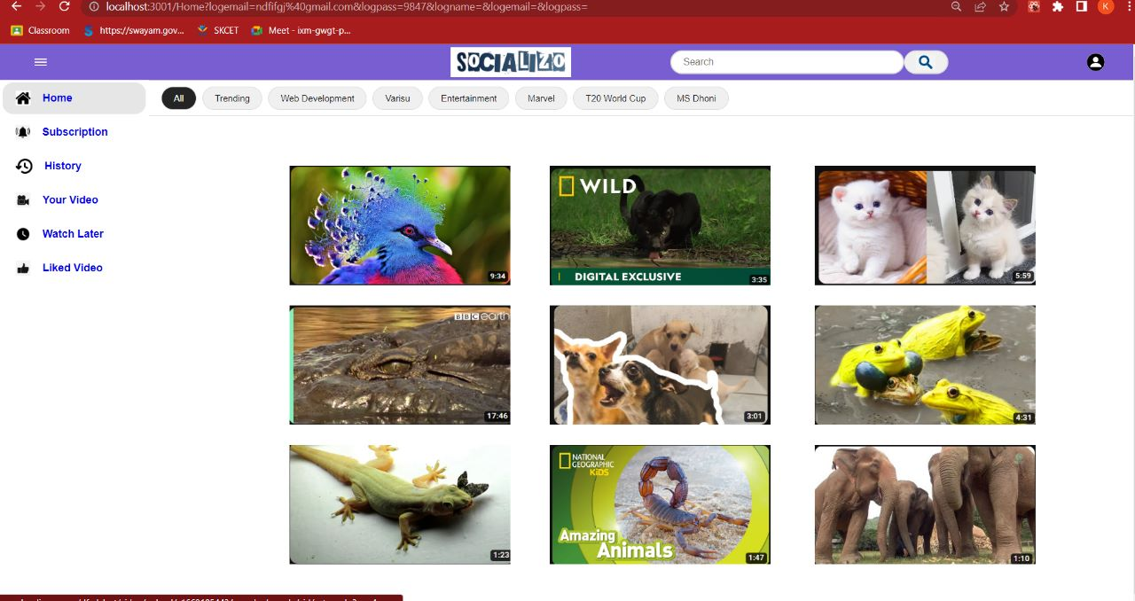
ENJOY ALL YOUR SHOWS BY A SINGLE CLICK..USE SOCIALIZO.

Slide 7
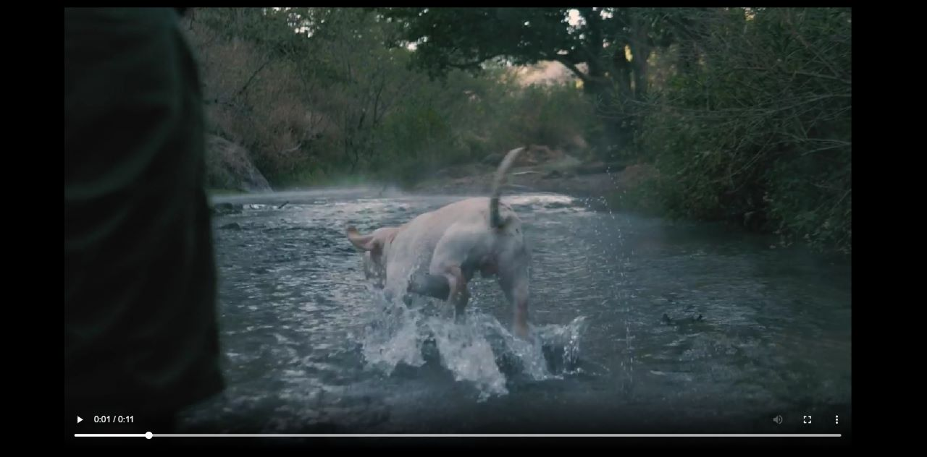
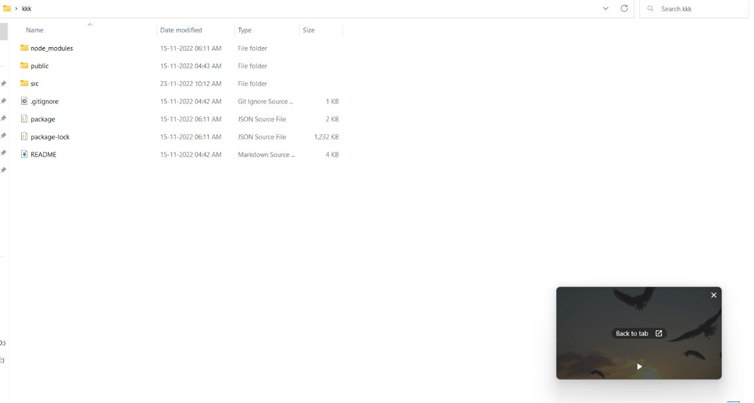
1
DOWNLOAD
We provided a download option , so that you can download the videos directly to your gallery.
2
PIC-IN-PIC MODE
The PIP feature lets you to watch a supported video in a small, minimised window.
PIC-IN-PIC MODE
3

Slide 8
TEAM EXECUTE
BY,
HARISH M
SHAIK CHANDINI
KISHORE K
IMAYAVARMAN M
KOUSHIK M
DHANUSH KUMAR S

